Slide 1
INDUSTRIAL INTERNSHIP REPORT
By Priyal Bhardwaj
18BIT0272

Slide 2

Company Details
Company Name : Optum - UnitedHealth Group
Contact Person : Mr. Rajat Bansal
Contact Number : +91 771885198
Email Address : rajat_bansal10@optum.com
Website : www.optum.com

Slide 3
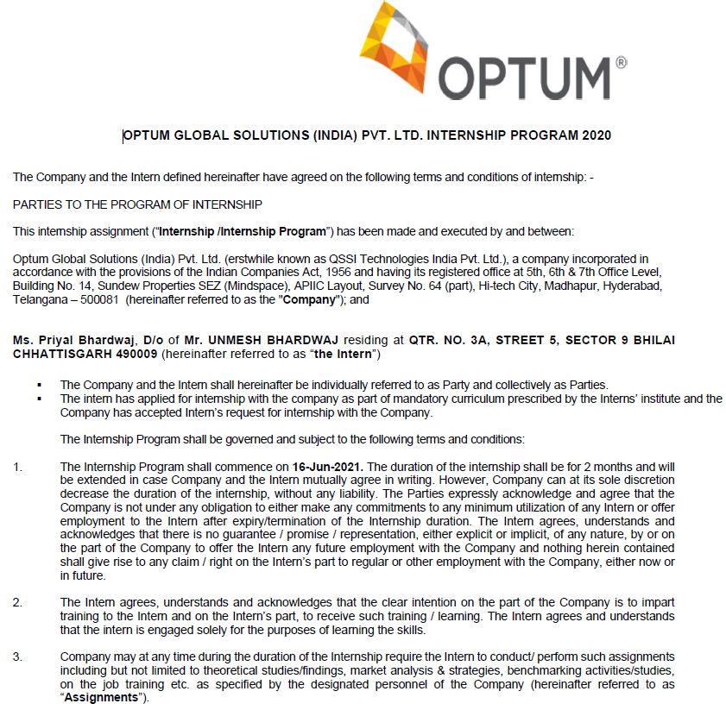
Offer Letter
Date of Joining : 16th June, 2021
Date of Completion : 15th August, 2021
Duration : 61 Days
Position : Software Development Intern
Domain Assigned : Java Backend Developer

Slide 4
About the Company
Optum - UnitedHealth Group, is an American pharmacy benefit manager and health care provider. It is a subsidiary of UnitedHealth Group since 2011.
UHG formed Optum by merging its existing pharmacy and care delivery services into the single Optum brand, comprising three main businesses: OptumHealth, OptumInsight and OptumRx. Optum has been operating in India since 2006 and has teams supporting health care operations, product development, automation, analytics and data solutions.

Slide 5
Basic Functionality
Spring Rest API for LDAP Login
Spring Rest API for JWT authorization
Implemented ER diagrams in MySQL
Spring Rest API using Hibernate for Projects page and Testcase page
API testing using Postman
Integration of APIs with Frontend
Deployment of APIs on Docker and Kubernetes via GitHub

Slide 6
Tasks to be done by me
Create ER Diagram for the modules as per the user requirement for the project.
Develop the REST APIs using Spring Boot, a Java Framework, and MySQL Database.
Test the modules, using any software testing tools, like Postman and send it to the supervisor.
Create proper documentation of the REST APIs developed and send it to the Frontend Team.
Assist in the integration of the REST APIs to Front-end, using AngularJS.

Slide 7
Help in the deployment of the web-app using Docker and Kubernetes.
Attend meetings regularly through Microsoft Teams.
Meet deadlines and be available whenever required by the team.
Ensure that the Backend Tasks are completed on time and ready for smooth integration with Front-end.

Slide 8
Modules developed in the entire duration
Spring Rest API for LDAP Login
Spring Rest API for JWT authorization
Implemented ER diagrams in MySQL
Spring Rest API using Hibernate for Projects page and Testcase page
API testing using Postman
Integration of APIs with Frontend
Deployment of APIs on Docker and Kubernetes via GitHub

Slide 9
Languages, Frameworks and Libraries Used and Learnt
Java
Spring Boot (Java Framework)
MySQL database for local deployment
Hibernate ORM
Rest API

Slide 10
Tools used
Git and GitHub, for version control and collaboration with the team
Postman to test REST APIs developed
Docker and Kubernetes for deployment

Slide 11
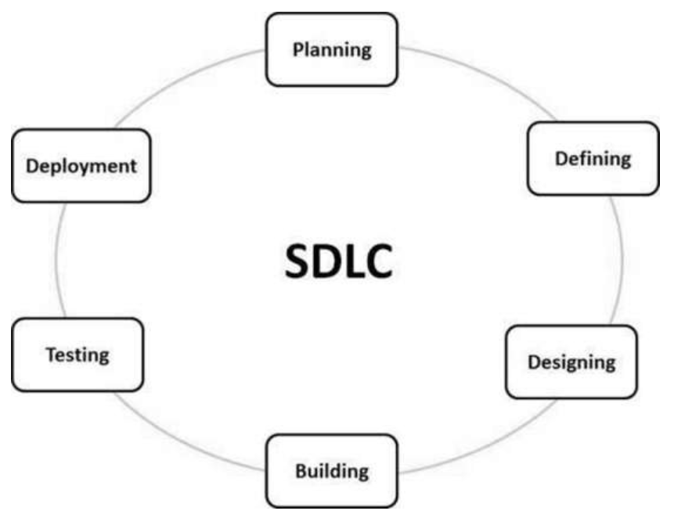
The entire development followed the Software Development Life Cycle.
Planning : My supervisor planned on what had to be done.
Defining : On the basis of the plan required, we decided what tools were required
Designing : I developed the ER model.
Building : This was the coding phase
Testing : The APIs were tested using Postman.
Deployment : The APIs were deployed to AWS by the DevOps team while I observed.

Slide 12
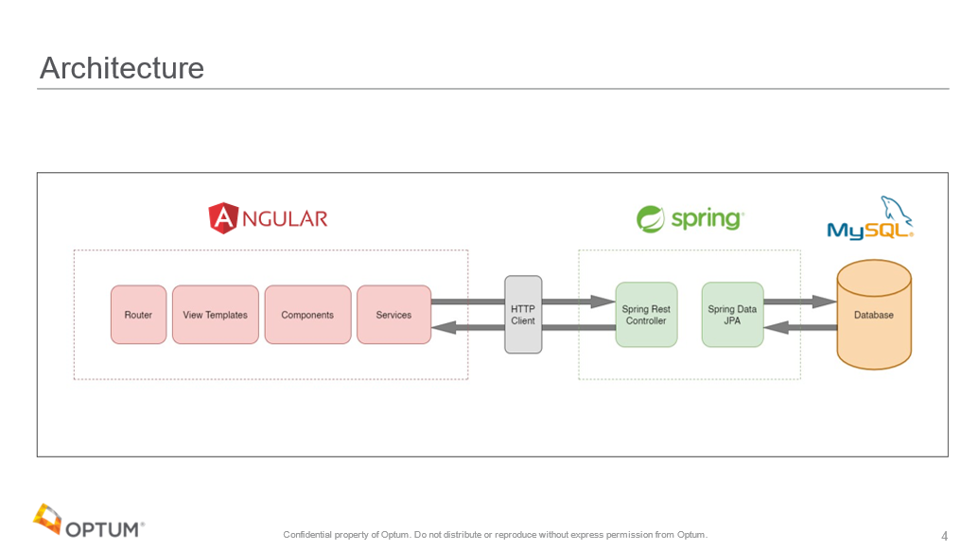
Architecture

Slide 13
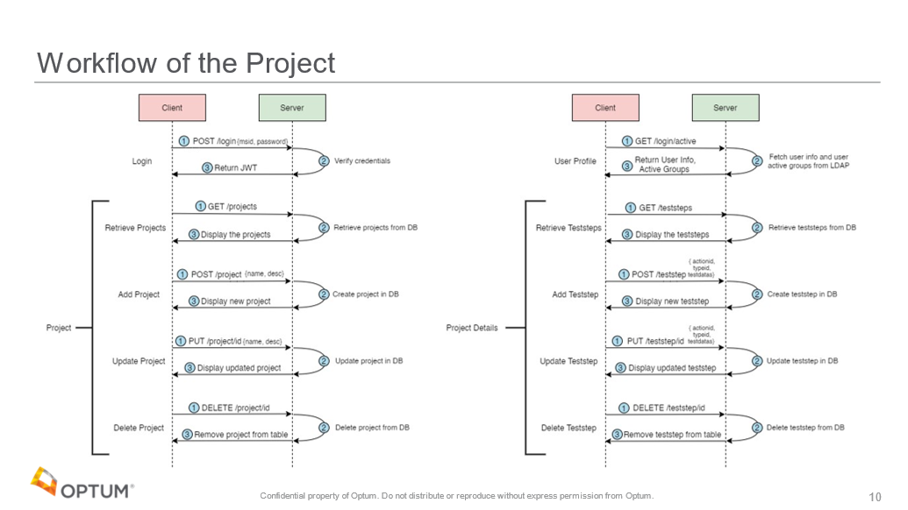

Slide 14
About the code
The code was developed using Object Oriented Programming Concepts like Classes, Objects and Inheritance.
Proper Functions were used to handle the different http requests like GET, POST, etc
The code was developed in such a way that it does not throw any arbitrary error.
Proper Error Handling was used.
Try - Except blocks were used in almost the complete code to minimize chances of error.
Proper Status Codes were sent as Response.

Slide 15
Json Web Tokens
JWTs are used for securely transmitting information between parties as a JSON object.
JWTs can be signed using a secret (with the HMAC algorithm) or a public/private key pair using RSA or ECDSA.
JWTs contain 3 parts separated by a ‘.’
Header
Payload
Signature
I used SHA256 to digitally sign this signature

Slide 16
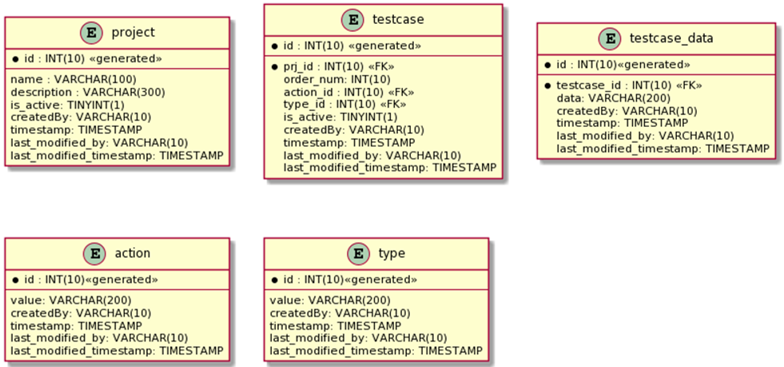
ER Diagram
The complete ER model was not developed at once. The ER model was developed functionality wise. For example, the Projects model was developed, then the Testcase and Testcase_data models were developed.

Slide 17
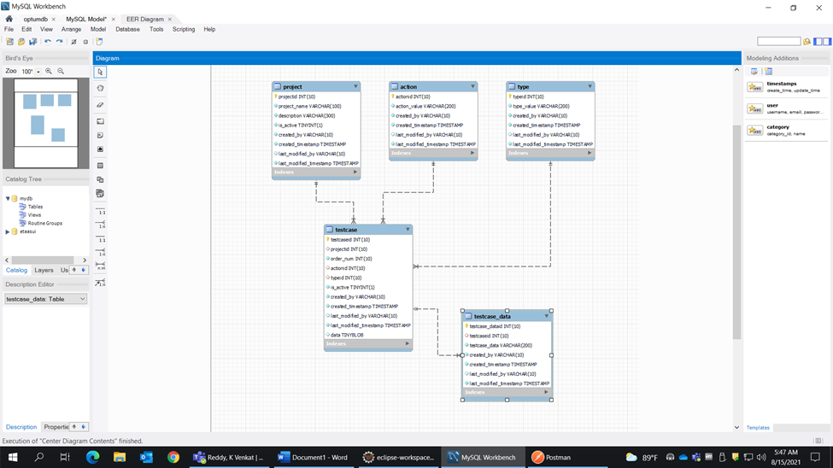

Slide 18
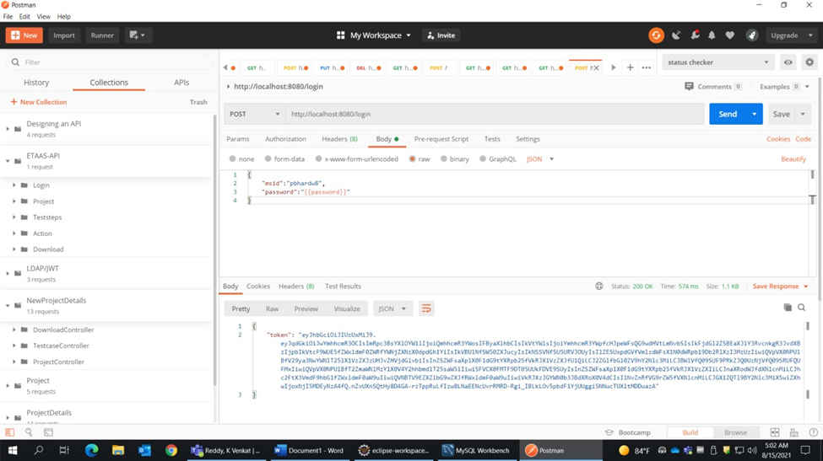
Postman
I learnt how to use Postman properly.
Postman is a great tool to test RESTful APIs I had made.
It offers a sleek user interface with which to make HTML requests, without the hassle of writing a bunch of code just to test an API's functionality.

Slide 19
Interaction with the Team
I was directly answerable to the Senior Manager, Mr. Rajat Bansal regarding the progress.
I reported and showed the testing of the APIs to Mr. Gaurav Nagpal, the Senior Software Developer.
At the time of my joining the Development team comprised of :
2 Frontend Developers
1 Backend Developer (myself)

Slide 20
Coordination and Working Hours
I had to coordinate with the Frontend Developers and work on my functionality and later on integrate the same.
This was easily integrated using Git and GitHub.
Every morning I had a progress meet with the mentors and scrum meetings in the evening where I was informed of my agenda for the day. And at evening, I informed if the work was completed or not,
The working hours were flexible. The agenda for the week or the deadline for a functionality was decided and I made sure that I met the deadlines.
Working Days were Monday - Friday usually. Sometimes it extended to Saturday

Slide 21
Meetings
Regular meetings were conducted for half an hour everyday to keep up to date with progress.
In the meetings, I had to give a detailed description of what I was working on, the extent of completion, by when will it be completed and what is the progress of the testing.
I was also told about the next functionality I have to develop after my current work has been completed.
Apart from meetings, quick calls were also done at times to discuss any bugs of utmost importance

Slide 22
Discussions and Suggestions
In the meeting, further functionalities to be built were discussed.
I always put in my views regarding the feasibility of the functionality regarding the technical aspect.
I also put forth my views keeping the user in mind.
After the UI development was complete, along with the team, I tried finding bugs and did a Usability Testing of the application.

Slide 23
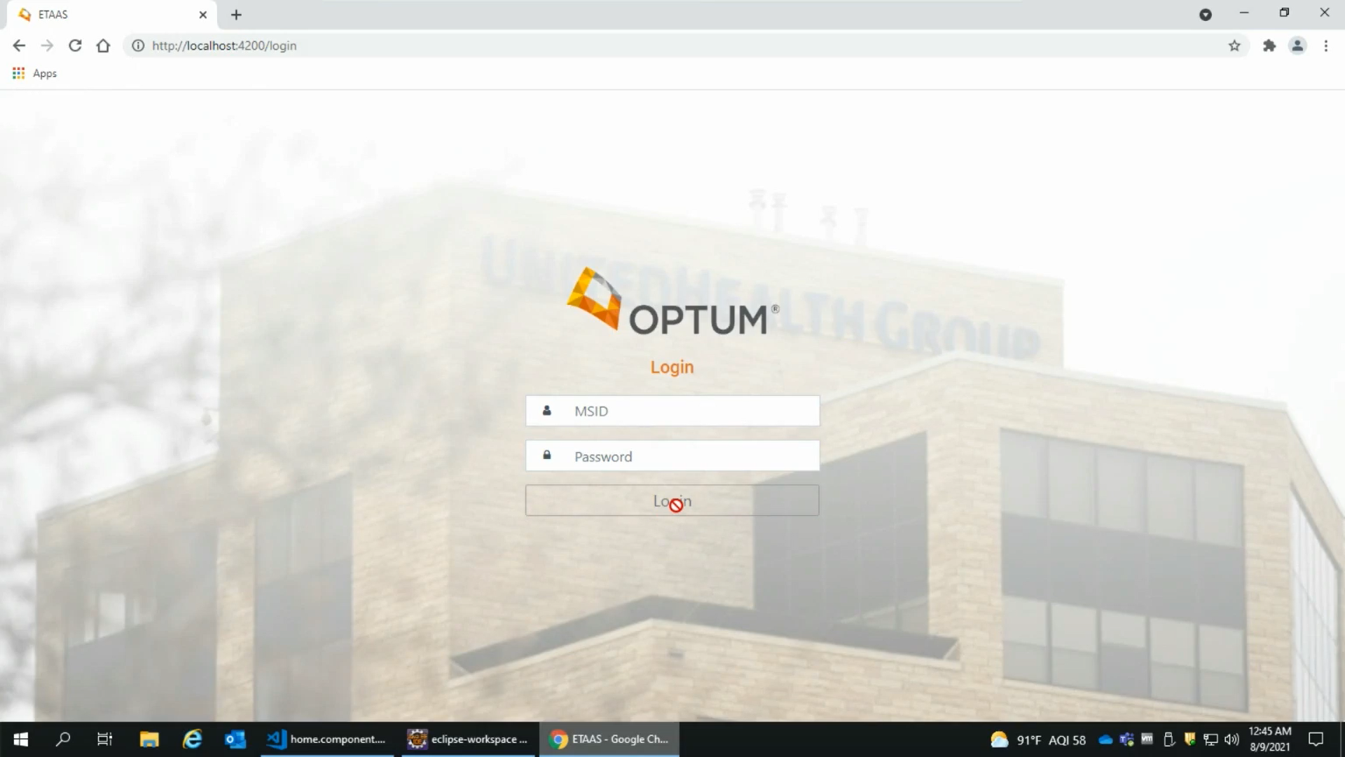

Slide 24
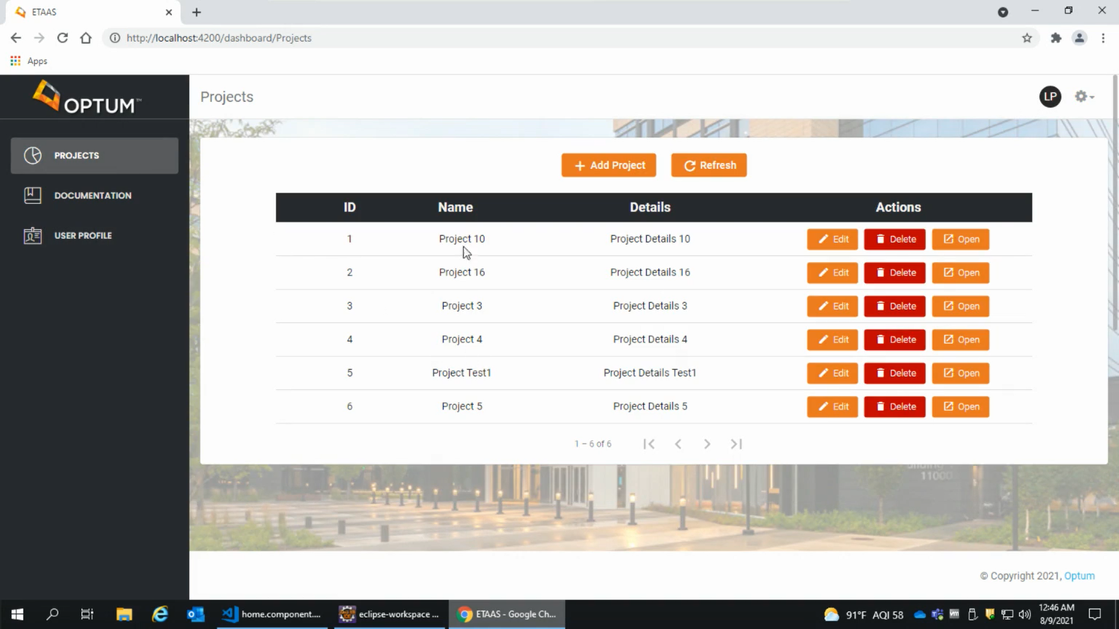

Slide 25
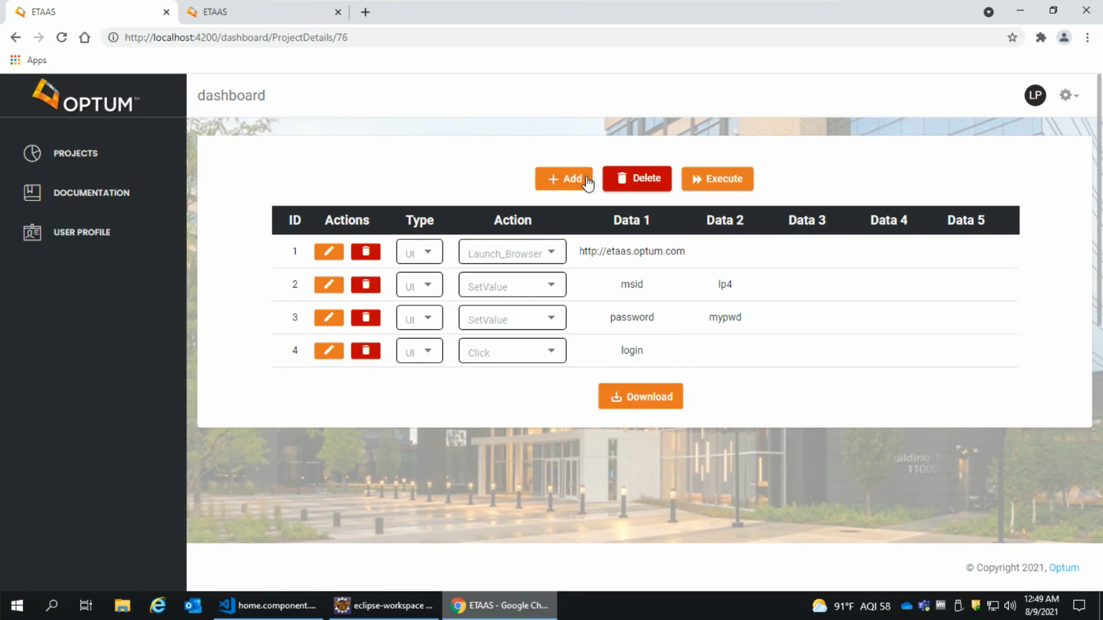

Slide 26
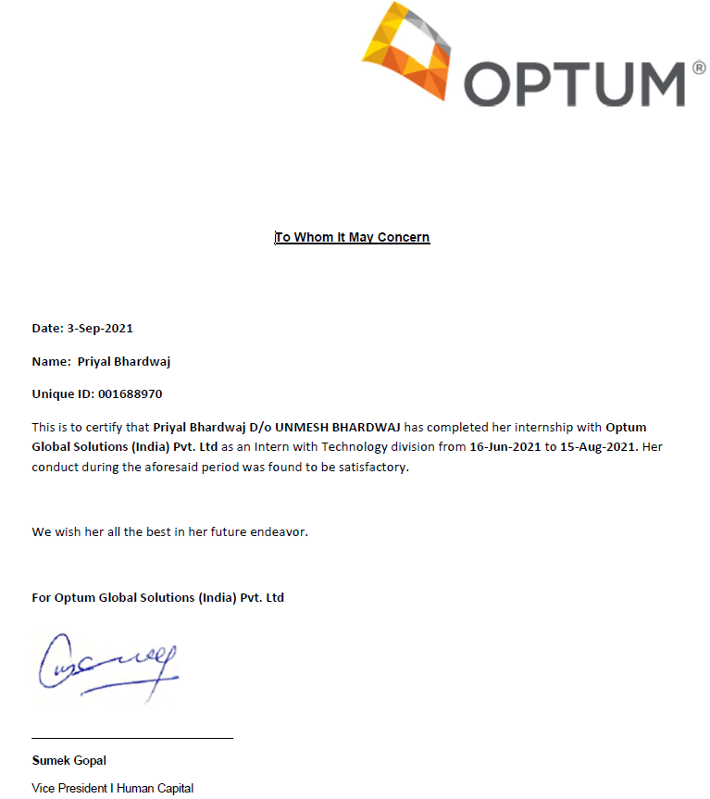
Here is my certificate of completion

